Slide 1
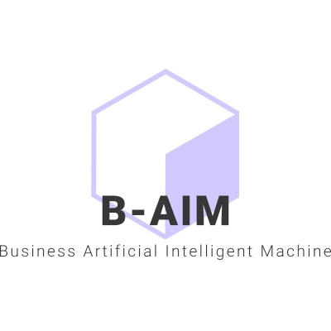
MatsyAI - Fisheries Information Systems
Presented by Kadiri Praveen Kumar
www.baim.store

Slide 2
Artificial Intelligence Singularity
18 AI applications to consider in Vizag Fishing Industry using Internet of Things at Fish Processing Plants to improve the Economy Standards and Safety of Food Processing

Slide 3
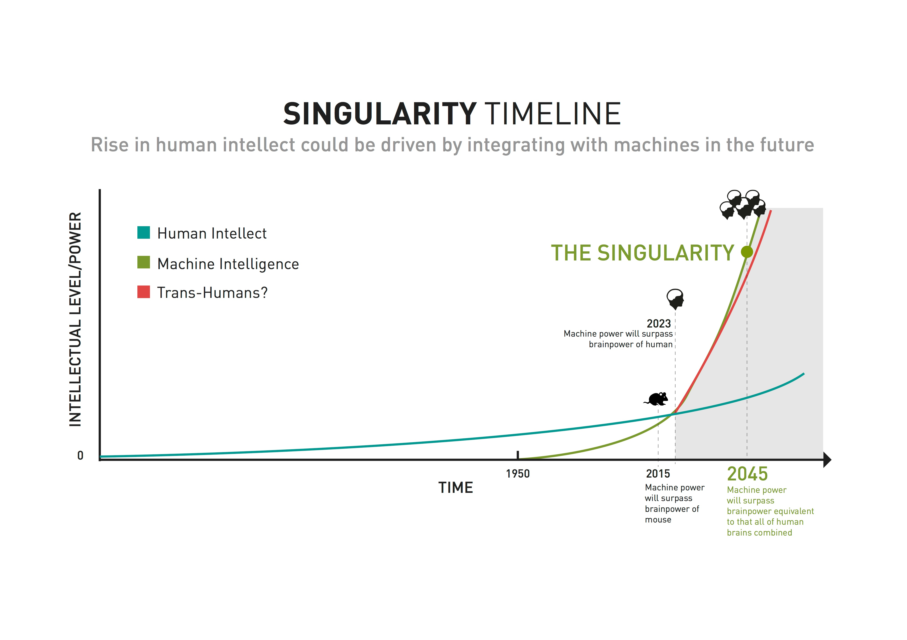
Singularity or Transcendence
In the field of artificial intelligence, or AI, The Singularity – or technological singularity – refers to a point in time when artificial superintelligence, will trigger an explosion of technology developments driven by machines that will change the world as we know it.

Slide 4
Brief about Each Application
Business Artificial Intelligent Machine(B-AIM)
4

Slide 5
1. Classification of fish species
How to organize fish breed into suitable classes and identify their ethnic relation with each other?
In general, the classification of various fish species manually could be a tedious task and it is important for the consumer to buy the right species.
So, building an Artificial Intelligence model which could classify the fish type manually, would be the best possible solution literally. A CNN(Convolution Neural Network) model is being used through deep learning concepts, which can detect the fish and predict the type of fish in a diverse number of scenarios with ease. An input image is sent to the CNN model, which will classify the fish species.
5

Slide 6
2. Automated Packaging and Unitization
How automated packing can improve the productivity in the IOT processing plants?
Automated packaging equipment allows retailers and manufacturers to streamline the packing process, increase productivity and make the most of available labor Something as simple as putting products in mailers, sealing those mailers and printing shipping labels over and over can quickly add up to a lot of wasted time
6

Slide 7
3. Fish Demand Forecasting
Why is it necessary to know which fish has more demand in the market?
Forecasting helps to inform how many units need to be ordered, preventing companies from spending money on inventory that won't sell. It is a powerful tool for businesses that are expanding into new territories with fluctuating demand.
7

Slide 8
4. Monitoring the import export demand of all types of fish.
The problem is to analyze the fish species being traded to different locations making location as the focal point.
The objective of the project is visualizing the data using Data Science and display the demand of various fishes being imported and exported using a timeline of various geographical locations across the globe, to understand and predict the economic impact on the Fishing Industry in Visakhapatnam
8

Slide 9
5. Detecting the fish quality in processing plant.
The problem is to analyze the fish quality, to check whether the fish brought to the processing plant are rotten.
The aim of this work is to ascertain with what accuracy can the prediction of Fish quality be detected using different Deep Learning algorithms, and Supervised Learning with the usage of RPA sensors.
9

Slide 10
6. Fish Disease Detection
To analyze the diseases affected by fishes and predict how to prevent further spreading
The application aims at detecting the major reasons and displays the type of disease the fish are infected. We can then have an opportunity to examine and prevent further spreading it to healthy fish in the other ocean territories at regular intervals of time so get more catch and revenue every year.
10

Slide 11
7. Order Tracking Chatbot
Providing a rapid solution for order tracking and feedback system.
Our model deals about the order tracking and feedback system. We provide the delivery status of the shipping items and we also take the customer feedback for improving the services.
11

Slide 12
8. Marine Life - Food Habitat Recognition System
Providing a rapid solution to acquire food details of a specific fish for future Research and Development.
Our model deals about the food details of the fish. We see many sites about fish data, but they won’t provide multiple details. So, we are coming with a solution for that. This model is used to give awareness on what kind of food does a specific fish rely on.
12

Slide 13
9. Border Detection System For Fisherman Using GPS and Arduino
What if the captain has approaching the border line and what are the guidelines that we are going to give to them?
We will be fixing an GPS tracker to the boat and will be able to see the exact location of the boat where it is going. If the boat is approaching towards the border that has been assigned to a certain state or country, then we will give an alarm or buzzer to the captain of the boat. We will be able to give an alarm or buzzer continuously till the boat come back from the border line
13

Slide 14
10. Data Analytics and Supply Chain Management in Fisheries
Finding out all the possible factors that influence the budget or expenditure of every member in the Supply Chain i.e Supplier, Manufacturer, Distributor, Retailer and Consumer.
Giving user the access to create a new criteria under which he can add expenses using a Customized Customer Relationship Management Software.
Searching over the internet for all possible areas where an expenditure can happen.
14

Slide 15
11. Tracking The Reasons For Extinction Of Fish Taking Preventive Measures using Fish Robot
The main objective of the project is to identify the reasons of endangered fishes and to find the preventive measures
Using Big Data from all the Datasets of all other applications we will be able to do the necessary research and find the reasons for major extinctions of marine life. This further would result in developing more useful applications in the Fishing Industry.
15

Slide 16
12. Fish Weight Prediction
To find the relationships among body Weight and to Age Ratio of the Ocean life
To address this limitation, Multi Linear Regression analysis is more suitable as a statistical method for reducing a complex system of correlations into one of smaller dimensions through the extraction of a few unobservable latent variables.
16

Slide 17
13. Sensors in IOT Processing Plant
How to process food in the processing plant with minimal human intervention to improve quality and safe output?
Encoding dummy variables can be derived from such multi regression analysis which could be nearly uncorrelated or orthogonal. Correlation Check and Removing Outliers could therefore be used for prediction, thereby solving the problem of multicollinearity.
17

Slide 18
14. Security for MatsyAI
How to Prevent malicious intruders from accessing the Client website?
To protect the data from malicious intruders, we will provide security to the website by adding a login module to keep track of user data, to block or unblock based on their activity.
Our analytics page can track the live status like IP address, location, currently active or not. We will even block right-click so that we can provide integrity of our data
18

Slide 19
15. Fisheries Information System- Frontend
UI/UX to provide information about the applications provided by the service provider
By using Wix ADI (Artificial Design Intelligence) we will be able to instantly build a personalized website for all the applications, complete with custom text and images. In This webpage we will project all the applications provided by the service provider
19

Slide 20
16. Back-end integration for fisheries information system
Integration of multiple applications in one platform
To integrate all applications, we collect the code and related data and deploy them in Heroku. Heroku is a cloud platform service supporting several programming languages. From Heroku, we get an HTML link that can be embedded into any web building platform like WordPress, Wix, or GoDaddy
20

Slide 21
Why 16 Applications?
Using AI Singularity with Deep Learning we are Creating a Preservative business model by Evolving the existing fishing practices that harm the Ocean life; simultaneously Produce safe and virus free food from the processing plants using Internet of Things(IOT) to Improve the living standards and to Educate the future generations of Fishing families in Visakhapatnam
21

Slide 22
Improving Safety Protocols
Creating
Preserving
Evolving
Order Tracking Chatbot
Border Detection System For Fisherman Using GPS and Arduino
Fisheries Information System- Frontend
Automated Packaging and Unitization
Detecting the fish quality in processing plant.
Back-end integration for fisheries information system
Fish Disease Detection
Fish Weight Prediction
Security for MatsyAI

Slide 23
Improving Economy Standards
Produce
Improve
Educate
Tracking The Reasons For Extinction Of Fish Taking Preventive Measures
Sensors in IOT Processing Plant
Fish Demand Forecasting
Monitoring the import export demand of all types of fish
Food Habitat Recognition System
Classification of fish species
Data Analytics and Supply Chain Management in Fisheries

Slide 24
MatsyAI Resources

Slide 25
Vizag Government Fisheries Department Insights
Recognizing the importance of fisheries sector, it has been identified as growth engine for economic development based on an evaluation of potentials of sectors to build on accumulated strength, to make significant impact on Gross State Domestic Product, and to exploit opportunities created by global trends.
Objectives of the Department:
Enhancement of production and productivity of fish and prawn
Optimum utilization of water resources for development of fishery wealth through eco-friendly practices
To promote per capita fish consumption
To create infrastructure facilities for fisheries development
To extend welfare measures to the fishers
Institutional and capacity building for
Women empowerment through their productive role
Nutritional security, quality promotion and value addition through cold chain development
Visakhapatnam district is primarily maritime district and large scale of coastal fishers are depending on fishing activity for their livelihood. The fisheries sector aims at exploitation of all the possible water resources under capture and culture fisheries for increasing fish production and productivity through sustainable development. The sector is contributing considerably for, food security, nutrition and health, lively hood security to rural population besides export earnings and welfare of fishers.

Slide 26
Numbers!!!!

Slide 27
THANK YOU. Contact Kadiri Praveen Kumar praveen.founder@baim.store 9052276938
Insert Image

